Slide 1
CS-UY 2214: Rec 2
Bitwise Operations and Verilog

Slide 2
Bitwise Operations

Slide 3
Bitwise Operations
Logical evaluates to BOOLEAN result (True/False)
Bitwise evaluates to NUMERICAL result
Operations | Logical | Bitwise
NOT | ! | ~
AND | && | &
OR | || | |
XOR | N/A | ^

Slide 4
Bitwise Operations - Patterns
0b1010 | 0b1100 10 OR 12
0b1 0 1 0
| 0b1 1 0 0
0b1 1 1 0

Slide 5
Bitwise Operations - Patterns
0b1010 & 0b1100 10 AND 12
0b1 0 1 0
& 0b1 1 0 0
0b1 0 0 0

Slide 6
Bitwise Operations - Patterns
0b1010 ^ 0b1100 10 XOR 12
0b1 0 1 0
^ 0b1 1 0 0
0b0 1 1 0

Slide 7
Bitwise Operations - Patterns
‘ | 1’ changes bit to 1
‘ | 0’ keeps bit the same
‘ & 0’ changes bit to 0
‘ & 1’ keeps bit the same
‘ ^ 1’ flips value of bit
‘ ^ 0’ keeps bit the same
Note: Any number xor itself is 0

Slide 8
Verilog

Slide 9
Verilog
Hardware Description Language
‘Assign’ is simultaneous rather than sequential (C++)
Simulates the behavior of hardware components

Slide 10
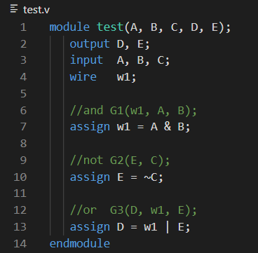
Verilog - Gates
A
w1
B
D
E
C

Slide 11
Verilog
Make sure terminal is in the same folder as file you want to run (cd *folder_name*)
Build:
iverilog -o test.vvp test_tb.v
Run:
vvp test.vvp

Slide 12
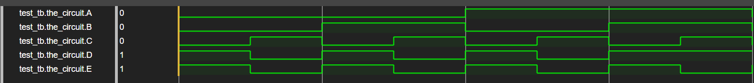
Waveforms
Visual for all outputs based on all input combinations
HIGH = ON / 1
LOW = OFF / 0
GTKWave (Requires Vital, VirtualBox, or Anubis Webtop) or Fliplot (Web-Based): https://fliplot.nickelp.ro/#
You could write your files in Anubis (NOT WEBTOP) and then run them in Anubis Webtop

Slide 13

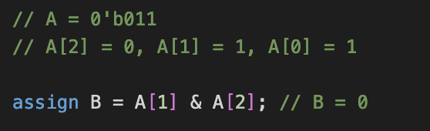
Verilog - Arrays
Multibit values can be viewed as array
Can separately access each bit for expressions

Slide 14

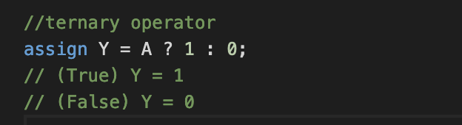
Verilog - Conditional Operator
Similar to if-else statements
Condition evaluates to 1 -> True
Condition evaluates to 0 -> False
Can nest conditional statements
Ex. “condition1 ? iftrue1 : condition2 ? iftrue2 : iffalse”

Slide 15
Good Luck! :)
(Feel free to ask for help anytime)
Notes:
P.S. Thank you Kevin - I’m sorry I basically plagiarized your slides
Notes to Self: Slow down, upload slides to Brightspace, only tell them what they CAN do

